Slide 1

Basic Circuit Laws and their Applications

Slide 2
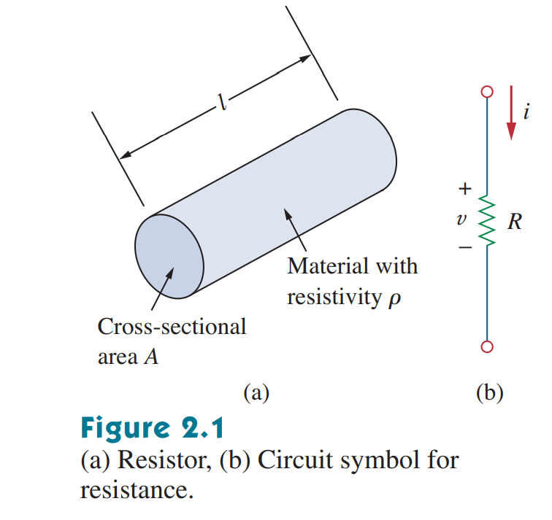
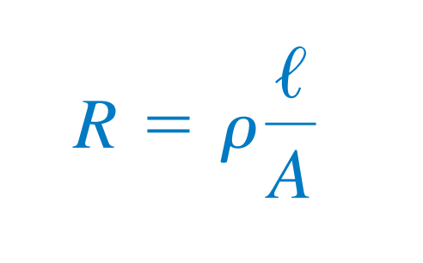
Resistance
R is resistance in ohms (Ω)
l is length of the conductor (m)
A is cross-sectional area of conductor (m²)
ƿ is Resistivity of the material
Notice the sign convention followed in the figure

Slide 3
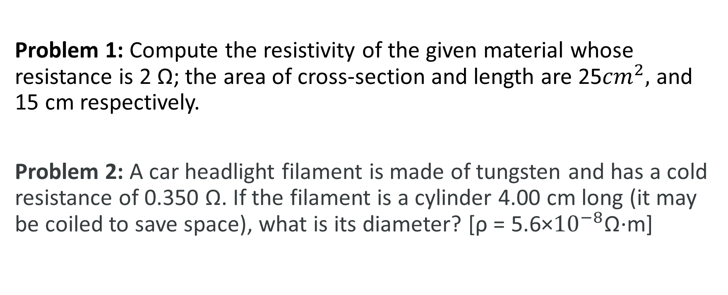
Practice Problem
Problem 1: Compute the resistivity of the given material whose resistance is 2 Ω; the area of cross-section and length are 25${cm}^{2},$ and 15 cm respectively.
Problem 2: A car headlight filament is made of tungsten and has a cold resistance of 0.350 Ω. If the filament is a cylinder 4.00 cm long (it may be coiled to save space), what is its diameter? [ρ = 5.6×${10}^{−8}$Ω⋅m]

Slide 4
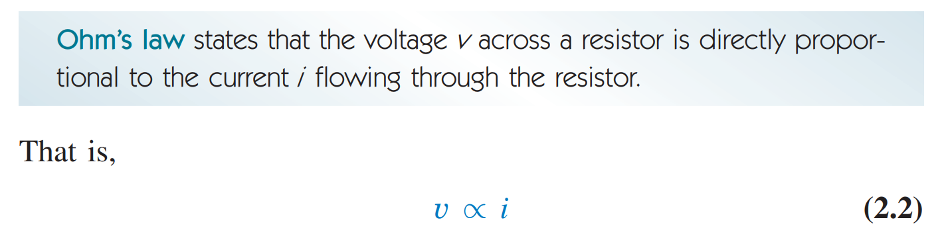
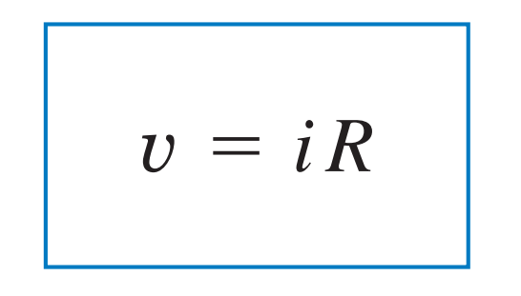
Ohm’s Law

Slide 5
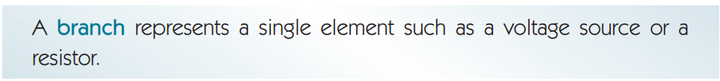
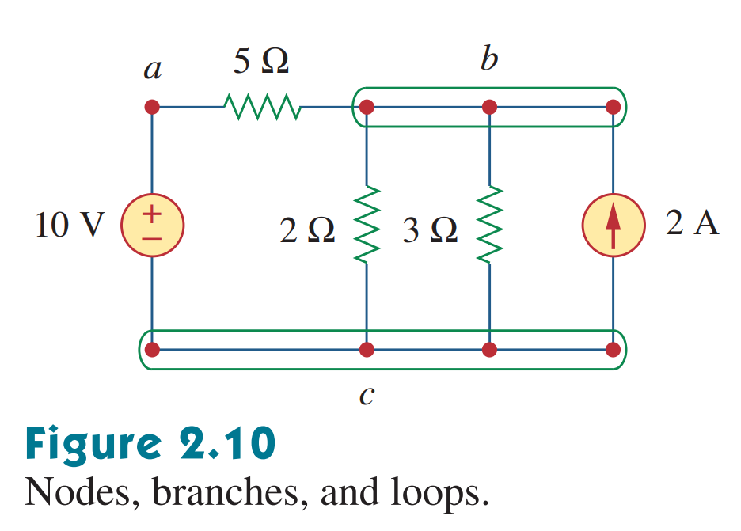
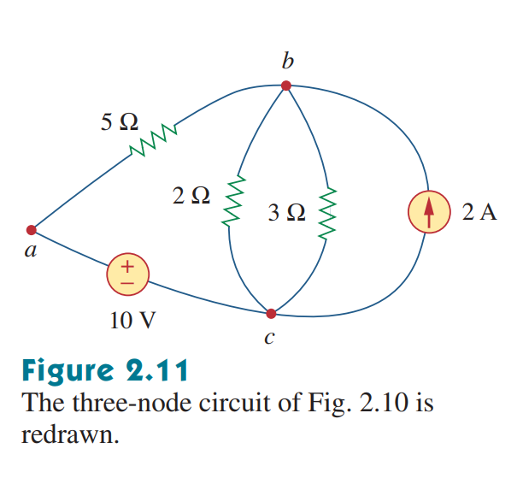
Branches and Nodes

Slide 6
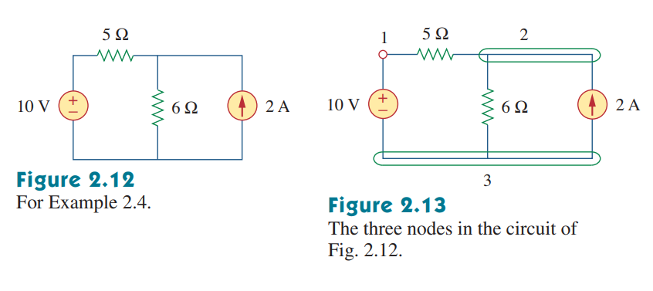

Slide 7
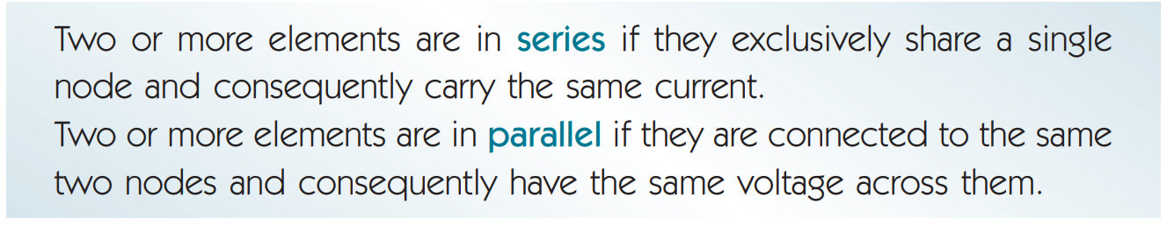
Series and Parallel Circuits

Slide 8
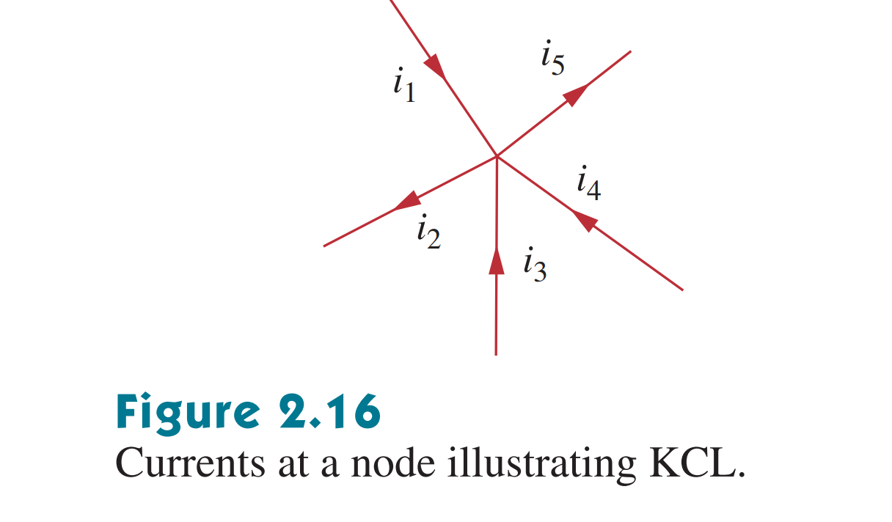

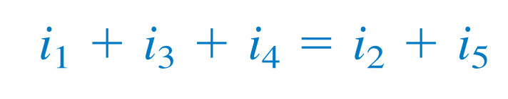
Kirchhoff's Current Law (KCL)

Slide 9
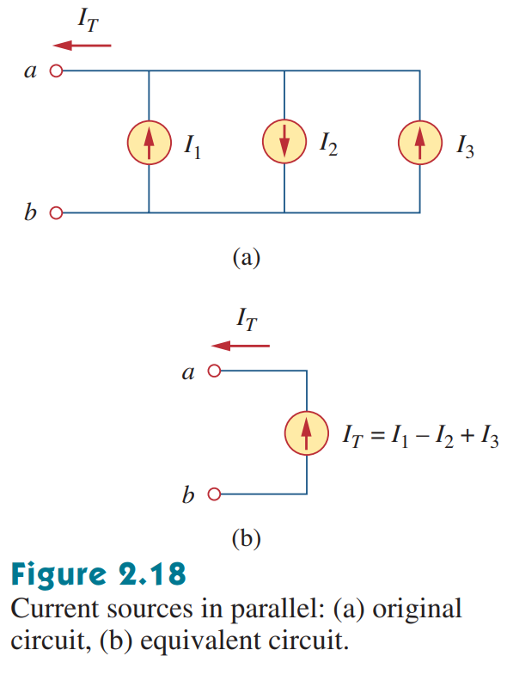
Applying KCL to Current Sources in Parallel

Slide 10
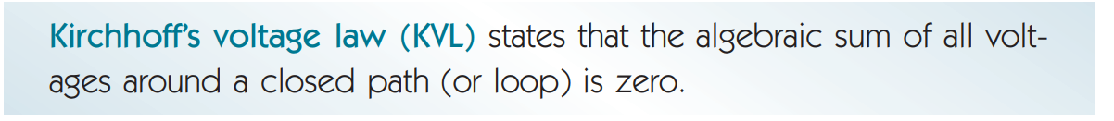
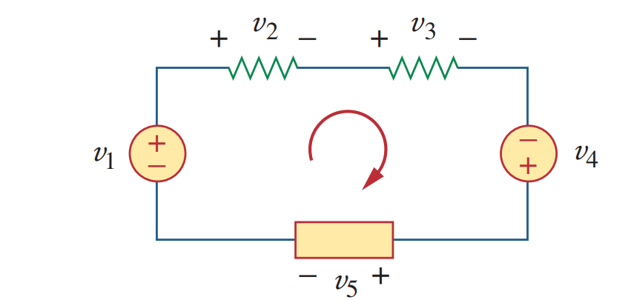

Kirchhoff's Voltage Law (KVL)
In the above example,

Slide 11
KVL Rules:
Assign currents in all the branches with suitable direction.
Name all the nodes and terminals.
Add voltage polarity (+/-) to all the elements according to assigned current direction.
Apply KVL by collecting voltages with appropriate signs along the independent loops.

Slide 12
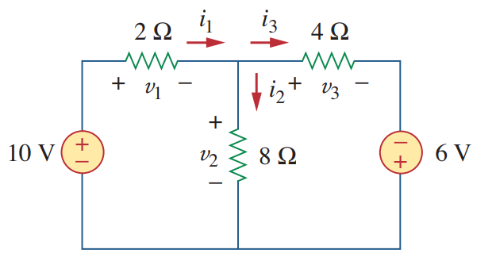
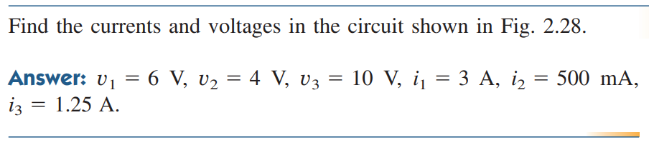
Math Problem Practice:
Reference: Sadiku_Practice_Problem_2.9

Slide 13
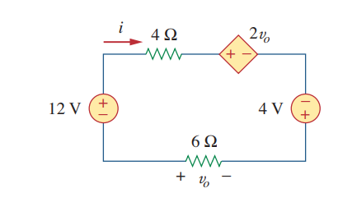
Math Problem Practice:
Reference: Sadiku_Example_2.6

Slide 14
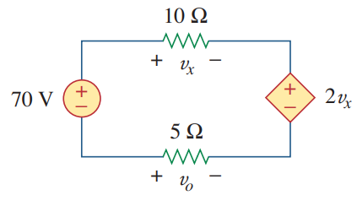
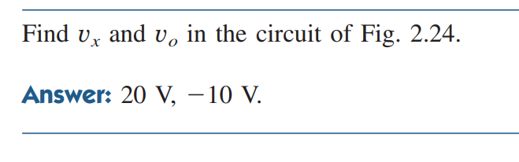
Math Problem Practice:
Reference: Sadiku_Practice_Problem_2.6

Slide 15
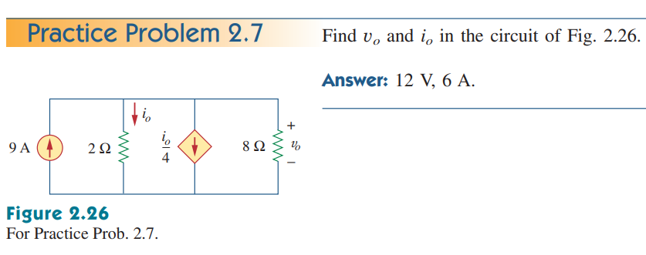
Math Problem Practice:
Reference: Sadiku_Practice_Problem_2.7

Slide 16
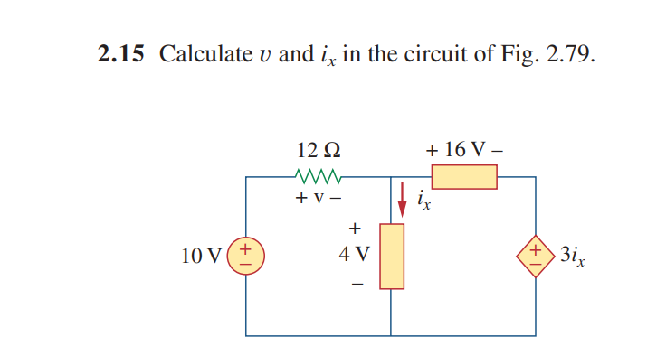
Math Problem Practice:
Reference: Sadiku_Exercise_Problem_2.15

Slide 17
Thank You

